Slide 1
Material Design
Nathaniel Breeden, Christopher Combs, Jonathan Winston, Nicholas La Raffa, Da'Montaye Snipes

Slide 2

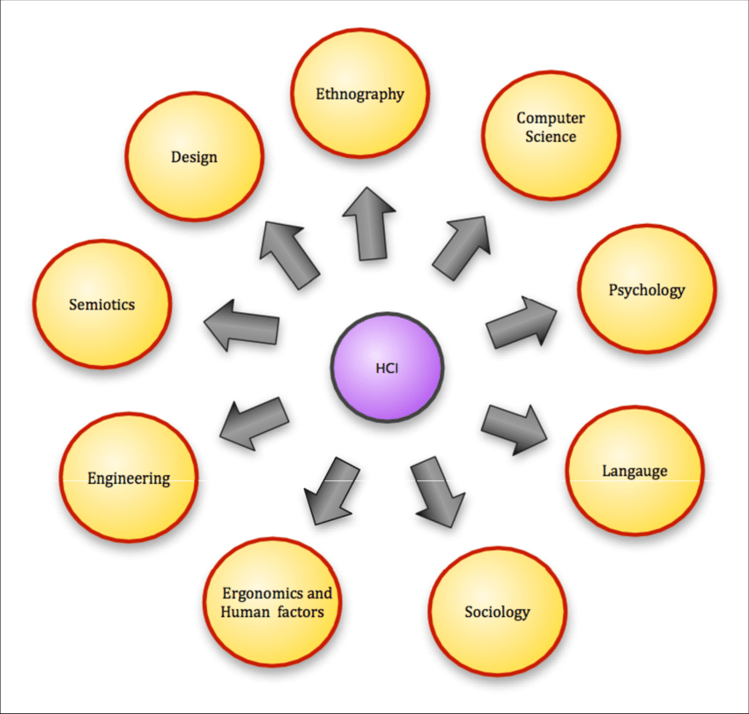
HCI-Human Computer Interaction
Human-computer interaction (HCI) is a multidisciplinary field of study focusing on the design of computer technology and the interaction between humans (the users) and computers. While initially concerned with computers, HCI has since expanded to cover almost all forms of information technology design.

Slide 3

HCI-Human Computer Interaction
(Cont.)
How Human interacts with Computer:
Not primarily the study of Human
Not primarily the study of Computer
The study of bridge between them, which includes
Observation of interactions between people & computers
Analysis of the involved interactions
Human consequences after interacting with computers, e.g., Can the user perform his task? Does he enjoy working with the computer?

Slide 4
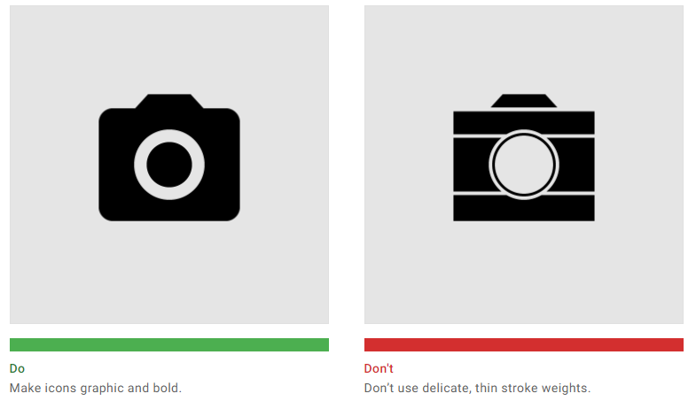
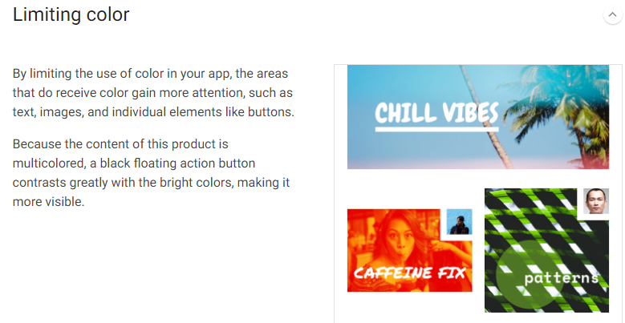
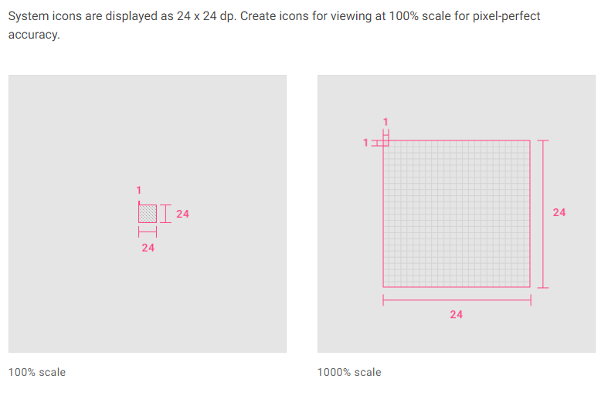
Material Design
Created by Google, Material Design is an Android-oriented design language.
It is a set of guidelines to help designers replicate googles design style.
Templates, grids and other information to help create a design.
Helps designers create an interface that users trust.

Slide 5
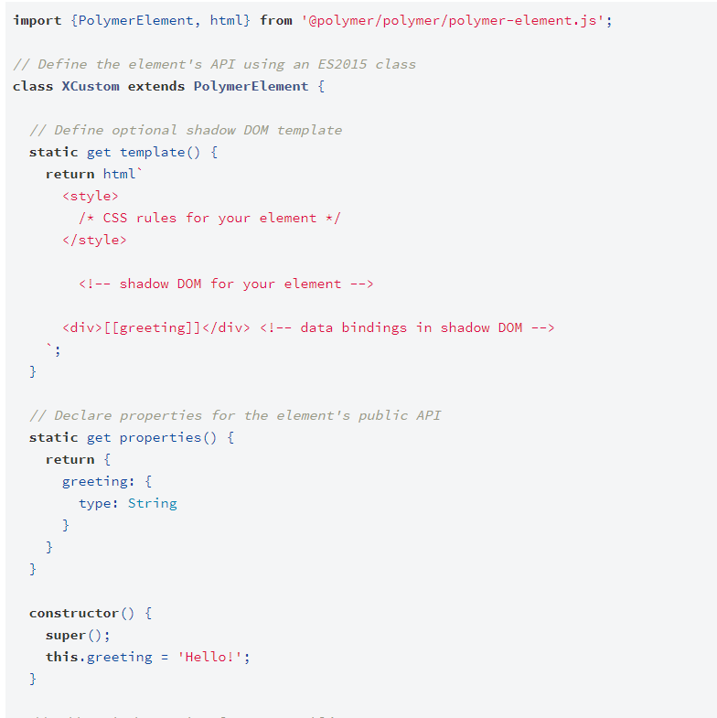
Polymer-project
An open-source JavaScript library for building web applications using web Components.
Allows you to create custom elements easily using the HTML, CSS, and JavaScript for adding interactions to the element.
Reduces amount of code.
Uses Spring session and OAuth2 for security

Slide 6

Google.com/design
A website created by google that is led by a group of designers, writers, and developers at Google.
It has a library full of case studies, profiles, and practical guides from many different designers.
The site has a resource section where you can find the latest material design tools and browse google fonts.
The Jobs section of the website explains roles that some might be interested in, like: UX Writer, Visual Designer, UX Program manager, etc. Along with a link to their career page where you can browse the latest design opportunities.

Slide 7
Google.com/design
A website created by google that is led by a group of designers, writers, and developers at Google.
It has a library full of case studies, profiles, and practical guides from many different designers.
The site has a resource section where you can find the latest material design tools and browse google fonts.
The Jobs section of the website explains roles that some might be interested in, like: UX Writer, Visual Designer, UX Program manager, etc. Along with a link to their career page where you can browse the latest design opportunities.

Slide 8
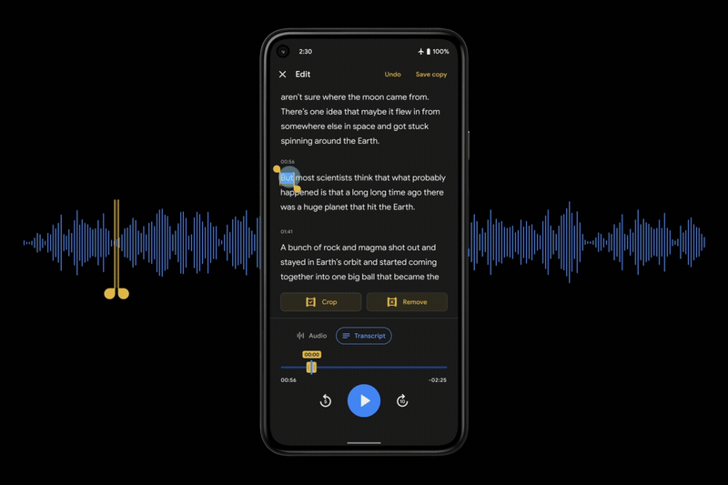
Google.com/design
A website created by google that is led by a group of designers, writers, and developers at Google.
It has a library full of case studies, profiles, and practical guides from many different designers.
The site has a resource section where you can find the latest material design tools and browse google fonts.
The Jobs section of the website explains roles that some might be interested in, like: UX Writer, Visual Designer, UX Program manager, etc. Along with a link to their career page where you can browse jobs related to designing.

Slide 9
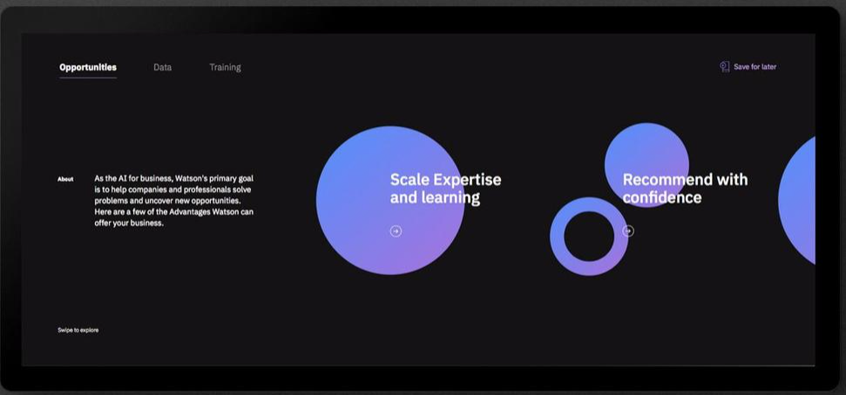
IBM design systems – UX design studio
"Design language to hold together a product" - Adam Cutler IBM design studio program director
Performance
Relative ease of communication
User experience focus
Reliability
Functionality
Product Unification
Why use IBM?
Easy to use
Reliable
Support
Communication

